Slide 1
Computer Organisation 1
Input devices
Sébastien Piccand
sebastien.piccand@ul.ie

Slide 2
Input devices
Keyboards
Pointing devices: Mouse, joystick...
Audio: Microphone, MIDI
Imaging and Video: Webcam, scanner, Fingerprint scanner...
Other: game controller, remote control
Haptic devices

Slide 3
Keyboards
Used to enter commands/text/numbers in the computer
One code per each key/combination of keys
Can be cordless

Slide 4
Keyboards
Layouts
  Inherited from typewriters
  Standard 102 keys: Contains letters, digits, punctuation and special keys (system keys, delete, tab, end, compositing keys...)‏
  Extended with functions keys/multimedia keys
  Language dependent: Qwerty, Azerty, Qwertz
  Optimized for minimum efforts: Dvorak

Slide 5
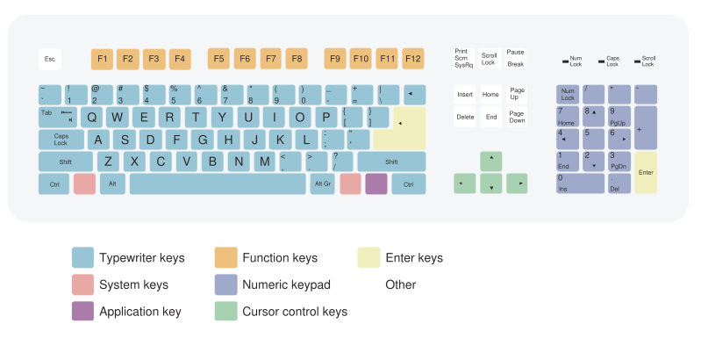
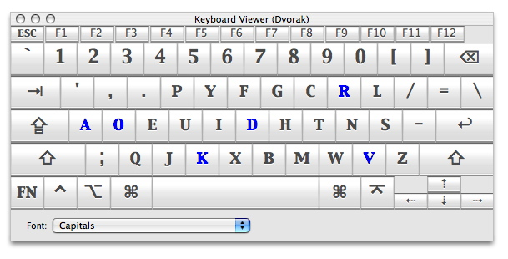
Keyboards
Layouts

Slide 6
Input devices
Keyboards
Pointing devices: Mouse, joystick...
Audio: Microphone, MIDI
Imaging and Video: Webcam, scanner, Fingerprint scanner...
Other: game controller, remote control
Haptic devices

Slide 7
Pointing devices
Gives information in 2D space
  (x,y) coordinate
  Resolution (in cpi/dpi): gives the speed
Selection buttons
Purpose
  Drawing
  Moving cursor
  Quick access to mostly useful options (open a file, copy, get info,...)‏

Slide 8
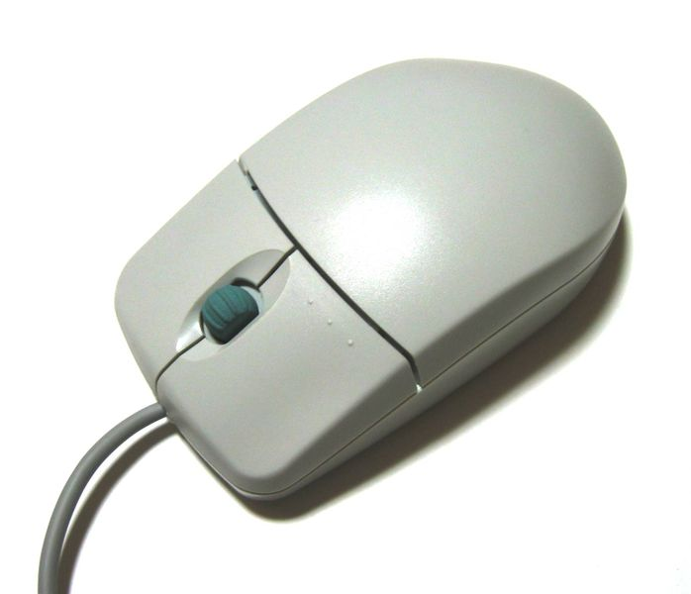
Pointing devices: mouse
Can be cordless
Different technologie
  Mechanical (ball)‏: ball rotates two wheels
  Optical (LED or Laser)‏: compare pictures

Slide 9
Pointing devices: mouse
Number of buttons
  1: Apple
  2: standard PC
  3 or more
  Scroll wheel
Degree of freedoms
  Normally 2 (x,y)‏
  Can add z, plus rotation (for 3D objects)‏

Slide 10
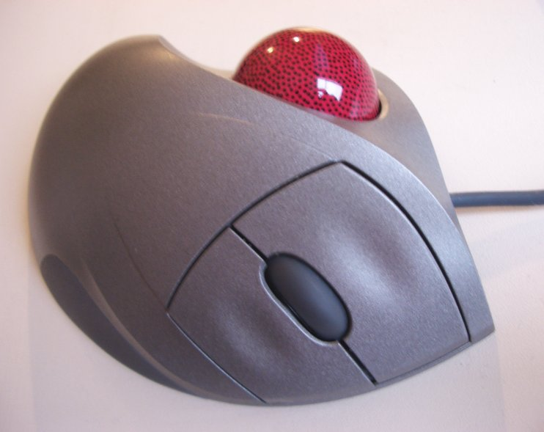
Pointing devices: trackball
« Reverse mouse »
The base does not move but contains a ball that can be rolled

Slide 11
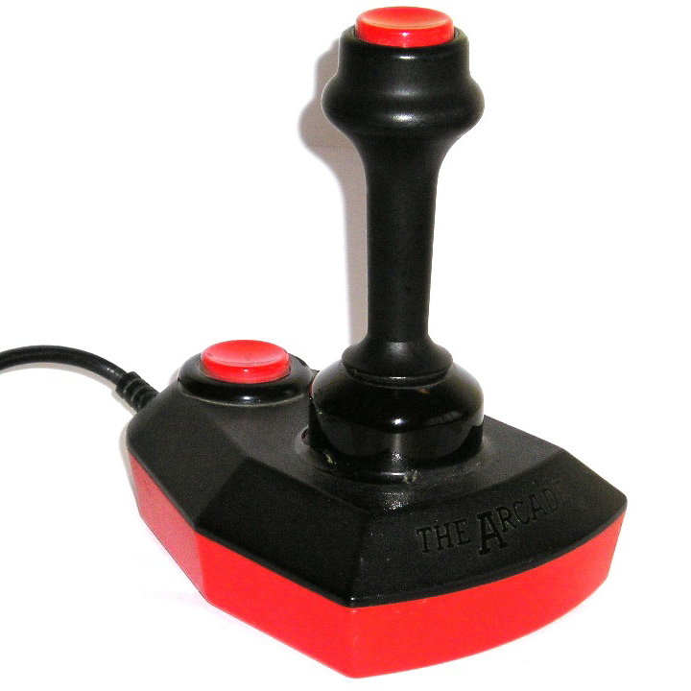
Pointing devices: joystick
Stick mobile on a base

Slide 12
Pointing devices: touchpad
Replaces the mouse on laptops
Rectangle delimiting (x,y) range
Can contain special areas for special keys/scrolling

Slide 13
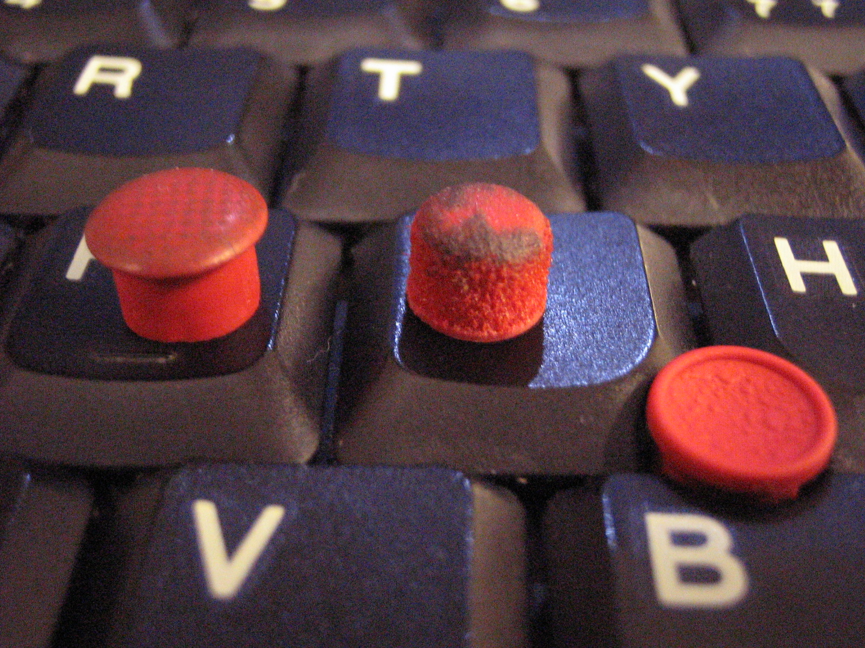
Pointing devices: pointing stick
A.k.a trackpoint, trackstick,...
Little stick included in the keyboard of some laptops (Thinkpad, Dell,HP...)‏

Slide 14
Input devices
Keyboards
Pointing devices: Mouse, joystick...
Audio: Microphone, MIDI
Imaging and Video: Webcam, scanner, Fingerprint scanner...
Other: game controller, remote control
Haptic devices

Slide 15
Audio input
Used to record sounds
  Voice: microphone
  Music: microphone, MIDI instruments‏

Slide 16
Audio input: microphone
Record any sound
Can be cordless
Can be used with a speech recognition software to enable sending commands to the system

Slide 17
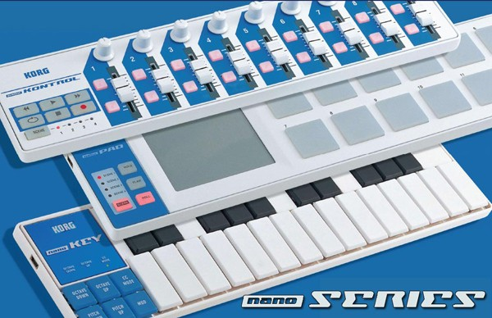
Audio input: MIDI instruments
MIDI: Musical Instrument Digital Interface

Slide 18
Audio input: MIDI instruments
MIDI data consists of notes characterized by:
  Pitch (height of the note: e.g. C#)‏
  Start
  Sustain
  Release
Instruments defines the timbre

Slide 19
Input devices
Keyboards
Pointing devices: Mouse, joystick...
Audio: Microphone, MIDI
Imaging and Video: Webcam, scanner, Fingerprint scanner...
Other: game controller, remote control
Haptic devices

Slide 20
Imaging and Video
Used to grab pictures or videos
  Scanner: fixed images
  Webcam: videos
Can be used with pattern recognition softwares to send command
  e.g. Fingerprint reader
... to send position
  e.g. Eye tracker

Slide 21
Input devices
Keyboards
Pointing devices: Mouse, joystick...
Audio: Microphone, MIDI
Imaging and Video: Webcam, scanner, Fingerprint scanner...
Other: game controller, remote control
Haptic devices

Slide 22
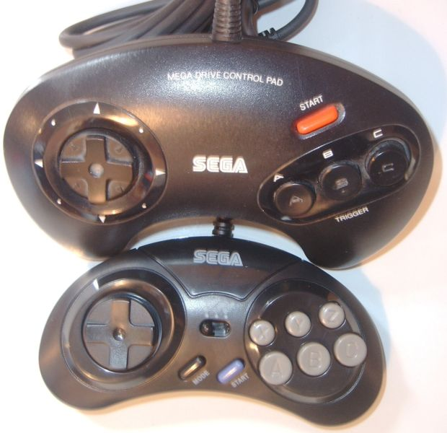
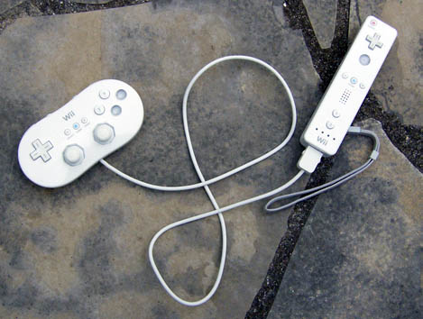
Other: game controllers

Slide 23
Other: game controllers
Mostly button based + pointing device
  Joystick, Joypad
Specialised game controllers
  Wheel + pedals, Yoke (aircraft), light gun
  Wii: motion sensor (3D accelerometer), position (infrared)‏
Force feedback information
  Mostly rumble

Slide 24
Other: remote control
Like a cordless keyboard
Usually keys for multimedia
Uses infrared

Slide 25
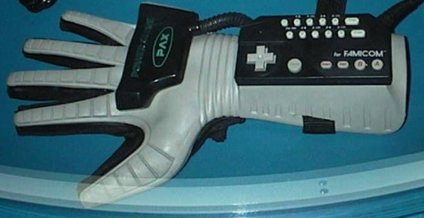
Other: gloves
Buttons on the top
Position of the glove in space
Bending of fingers
Motion tracker
Examples
  P5 glove (USB)‏
  Power Glove (Nintendo)‏

Slide 26
Input devices
Keyboards
Pointing devices: Mouse, joystick...
Audio: Microphone, MIDI
Imaging and Video: Webcam, scanner, Fingerprint scanner...
Other: game controller, remote control
Haptic devices

Slide 27
Haptic devices
Gives reality like feedback information
Allows better immersion in a virtual environment
Application
  Games
  Virtual reality
  Medicine
  Teleoperators and simulators

Slide 28
Haptic devices
Type of feedback information
  Weight of objects (if moving them)‏
  Inertia (flight simulator)‏
  Density of objects (soft, hard)‏

Slide 29
Haptic devices
Sensable
  http://www.sensable.com/haptic-application-gallery.htm
  http://www.sensable.com/haptic-application-videos.htm
Haptic community
  http://haptic.mech.northwestern.edu/intro/gallery/index.html

Slide 30
Summary
Input devices
  Keyboards
  Pointing devices
  Audio
  Graphics/Video
  Others
  Haptics

Slide 31
Future
Brain-computer interfaces?
  Using Electroencephalography (EEG)‏
  http://www.youtube.com/watch?v=qCSSBEXBCbY

